Slide 1





A..X..I..O..R..A..’26
Title>
Team Fast&Curious presents to you
INFOSHIELD-AI
AGENTIC AI SYSTEM FOR REALTIME FAKE NEWS DETECTION

Slide 2


Team: Fast&Curious presents InfoShield-AI
Title>
The-Problem>
Rapid spread of FAKE NEWS on social media
Difficult to verify real time and unknown news.
Existing systems: static dataset,no explanation,not realtime
Need: Explainable real time ai system
PROBLEM
STATEMENT

Slide 3

Team: Fast&Curious presents InfoShield-AI
Title> The-Problem>
Solution>
Inputs
Direct Text
News URLs
Social Media (Reddit/YouTube)
Screenshots (OCR)
System
Agent-based pipeline (automated)
Outputs
REAL / FAKE verdict
Confidence Score
Transparent
SOLUTION

Slide 4


Team: Fast&Curious presents InfoShield-AI
Title> The-Problem> Solution>
Workflow>
input
input
handler
claim
extraction
WORKFLOW
text or url
Output API
+
Streamlit
verdict
scoring
engine
linguistic
analyzer
bart-minli
classifier
evidence
retrieval

Slide 5



Team: Fast&Curious presents InfoShield-AI
Title> The-Problem> Solution> Workflow>
Tech-Stack>
TECHNOLOGIES
USED
Python
Flask
Streamlit
HuggingFace Transformers
BeautifulSoup
Newspaper3k
Tesseract OCR
NLTK

Slide 6


Team: Fast&Curious presents InfoShield-AI
Title> The-Problem> Solution> Workflow> Tech-Stack>
Uniqueness>
VALUE PREPOSITION
EXISTING SYSTEMS
* Use sentiment models (WRONG logic)
* No linguistic validation
* Weak evidence matching
* No thresholds → noisy outputs
INFOSHIELD - AI
* BART-MNLI (true classification)
* 20+ linguistic heuristics
* IDF-weighted evidence retrieval
* Hard thresholds (robust decisions

Slide 7
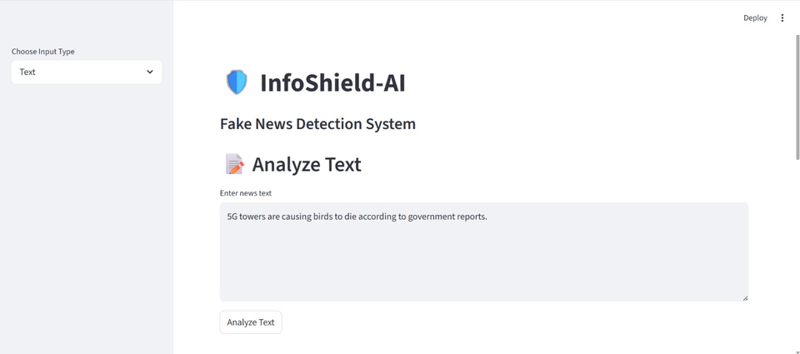
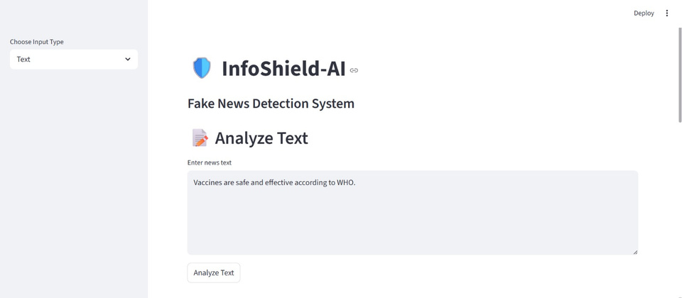
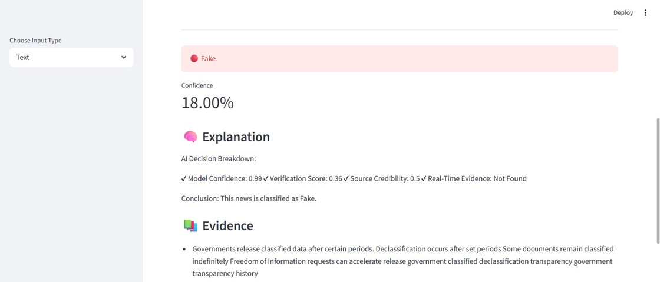
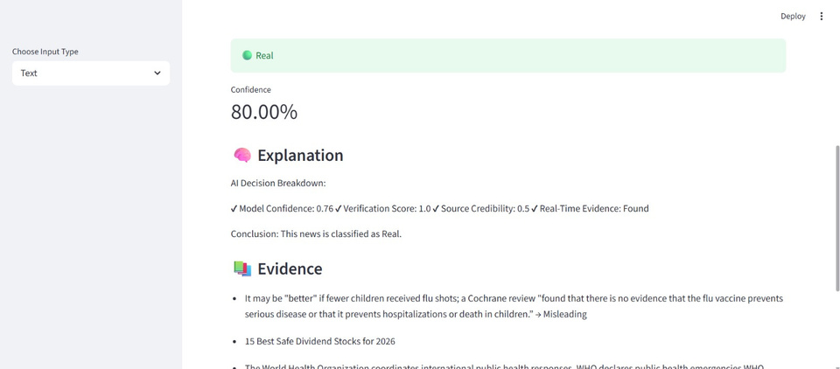
Team: Fast&Curious presents InfoShield-AI
..> Solution> Workflow> Tech-Stack> Uniqueness>
Demo>
WORKING PROTOTYPE
TEXT ANALYSIS

Slide 8
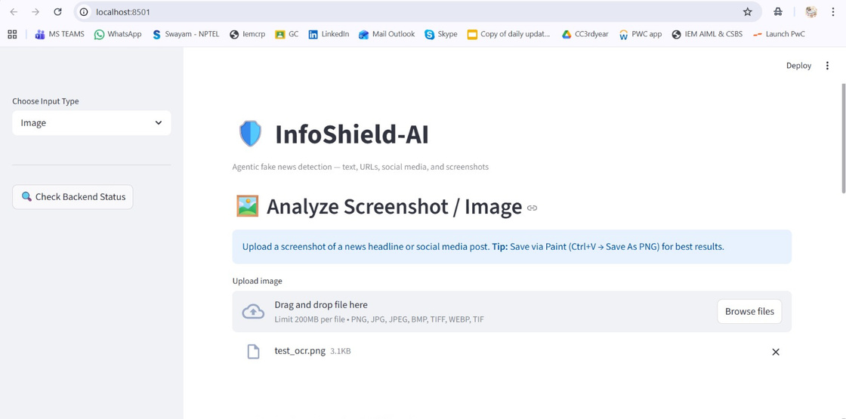
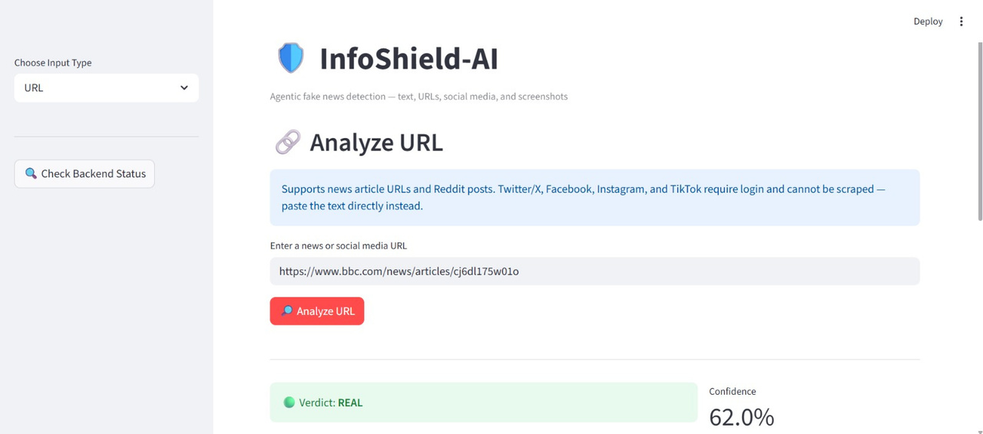

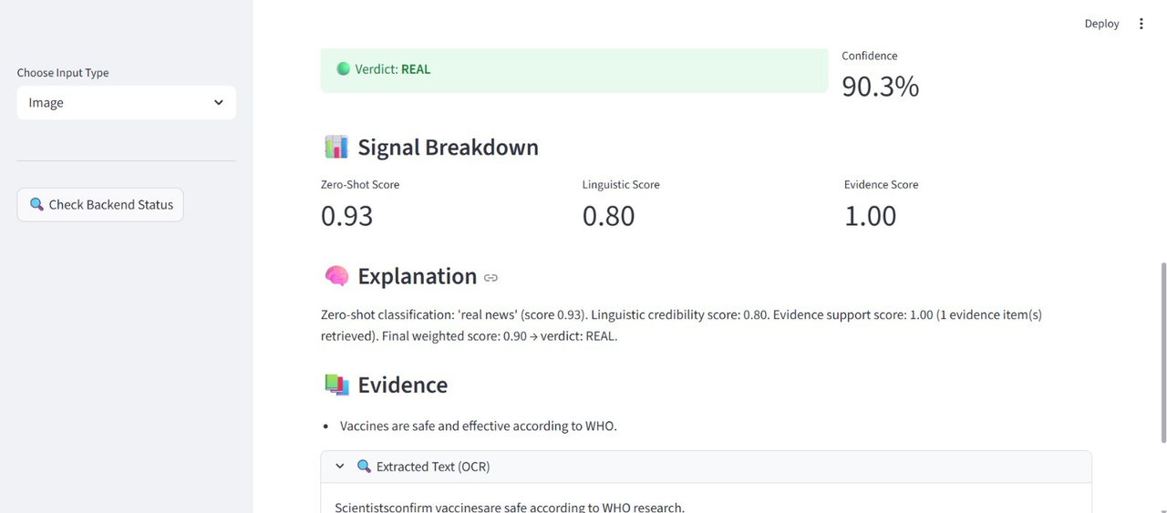
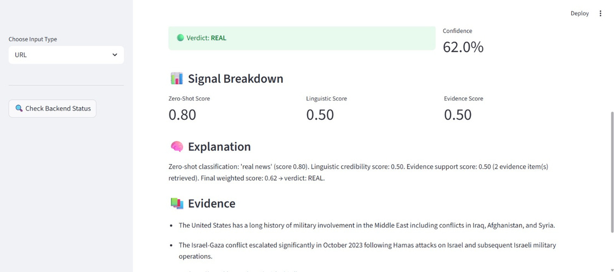
Team: Fast&Curious presents InfoShield-AI
..> Solution> Workflow> Tech-Stack> Uniqueness>
Working of the Solution (video demo)
Demo>
IMAGE ANALYSIS
URL ANALYSIS

Slide 9

Team: Fast&Curious presents InfoShield-AI
Timmerman Industries
..> Solution> Workflow> Tech-Stack> Uniqueness> Demo>
Next-Step>
LIMITATIONS
FUTURE SCOPE
LIMITATIONS
AND
FUTURE
SCOPE
Not fully trained on fake news dataset
Depends on available evidence
Social media API limits
Fine-tuned ML model
Database integration
Mobile app
Deployment (cloud)
Browser extension

Slide 10
Team: Fast&Curious presents InfoShield-AI
Timmerman Industries
..> Workflow> Tech-Stack> Uniqueness> Demo> Next-Step>
Conclusion>
Multi modal fake news detection system
Combines AI + real-time verification
Provides explainable ai
CONCLUSION

Slide 11

Team: Fast&Curious presents InfoShield-AI
This demonstration was presented by ...
..> Workflow> Tech-Stack> Uniqueness> Demo> Next-Step>
Conclusion>
THANK YOU!
Team Members:
Sajili Chatterjee
Ayisharya Mitra

